Slide 1
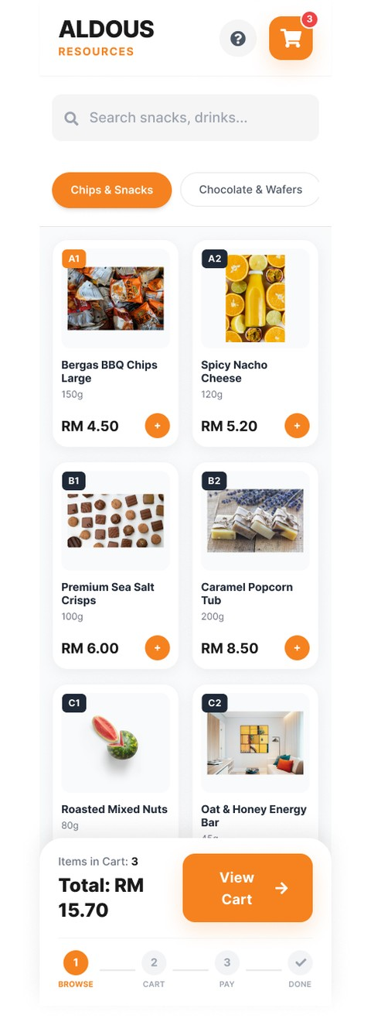
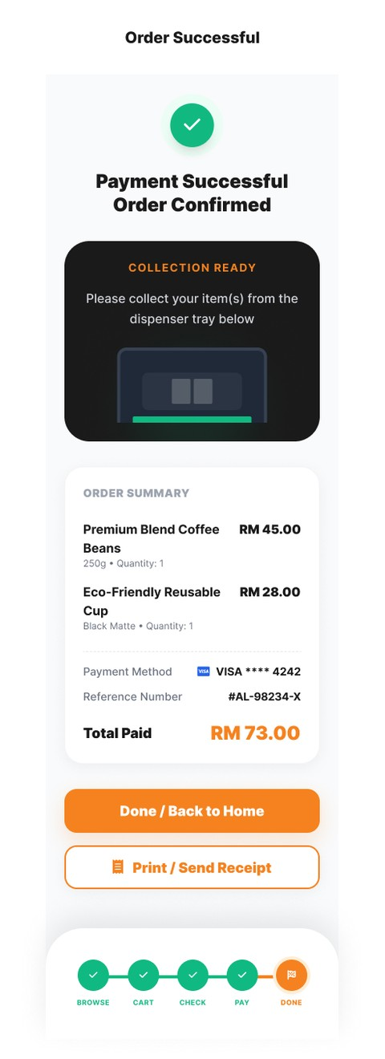
HCI3202 GROUP ASSIGNMENT · JUN 2026
The "ALDOUS RESOURCES" Vending Machine User Interface Design using Figma
MODULE
SESSION
HCI 3202 Human Computer Interface
JUN 2026
PROGRAMME
LECTURER
Bachelor of Information Technology (BITI)
KALA DEVI MANAGURAN
SECTION
GROUP NUMBER
6H1 / 6MB1
1
GROUP MEMBERS
1. Shahadat Hossain — I26041279
2. Rowan Cesar Macuacua — I25037217
3. Raduan Mia — I25035605
4. Morris Kinyua — I24028729
FIGMA PROTOTYPE — 8 TOUCHSCREEN SCREENS

Slide 2
ALDOUS RESOURCES · VENDING MACHINE UI
Contents
1.0
Introduction
5.0
Evaluation
2.0
Justification of Current Interface
6.0
Interaction Design
6.1 Prototypes — 8 Figma Screens
6.2 Justification on Prototype Design
3.0
Data Gathering Techniques
7.0
Conclusion and References
4.0
Target Users, Tasks and Sub-tasks
HCI 3202 · HUMAN COMPUTER INTERFACE · GROUP 1
02

Slide 3
ALDOUS RESOURCES · VENDING MACHINE UI REDESIGN
SECTION 1.0
1.0
Introduction
THE SITUATION TODAY
OUR PROPOSAL
• The vending machine at INTI International University, Nilai is fully manual — press a button, insert coins
• No screen, no guidance flow, no feedback for the user
• Students are confused about pricing, payment and product availability
• Cashless payment is growing fast across Malaysia
• Poorly designed self-service machines lead to more user errors and lower satisfaction (Ayob & Baba, 2025; Nielsen, 2020)
8
guided touchscreen
screens, built in Figma
• Covers the full journey: browse → pay → collect
• Clear prices, guided payment and error recovery
• Design decisions are driven by a survey of 43 INTI students
Redesign goal: instant feedback, clear steps,
and easy cashless payment for every user.
HCI 3202 · HUMAN COMPUTER INTERFACE · GROUP 1
03

Slide 4
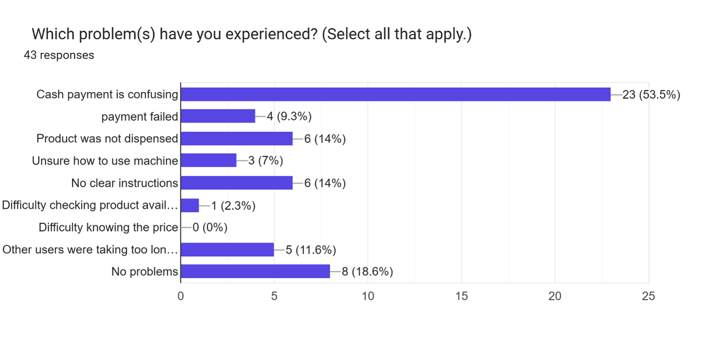
ALDOUS RESOURCES · VENDING MACHINE UI REDESIGN
SECTION 2.0
2.0
Justification of Current Interface
60.5%
of students experienced a problem when
using the current manual machine
• Top issues: cash payment confusing (53.5%), product not dispensed (14%), unclear instructions (14%)
• Only 39.5% say the current instructions are clear
• No feedback — users cannot tell if payment or selection worked (Nielsen, 2020)
• Ambiguous feedback lowers trust and causes abandoned purchases (Kang et al., 2023)
• Users with accessibility needs are excluded by a button-only machine
Figure 1. Problems experienced by students while using
the current vending machine (n = 43).
▸ Over half of all students struggle with cash payment — the strongest signal that a guided digital payment flow is needed.
HCI 3202 · HUMAN COMPUTER INTERFACE · GROUP 1
04

Slide 5
ALDOUS RESOURCES · VENDING MACHINE UI REDESIGN
SECTION 3.0
3.0
Data Gathering Techniques
01
02
03
04
Online survey
Google Forms shared with INTI students
43 valid responses
collected in a short time
Closed questions
multiple choice, checkbox, 5-point Likert scale
Open question
suggestions and personal pain points
WHAT WE ASKED
WHY A SURVEY
• Usage frequency of the vending machine
• Problems faced and instruction clarity
• Payment confusion and satisfaction level
• Preferences for a proposed digital UI
• Reaches a large sample quickly
• Students answer privately and honestly
• Gives quantifiable data for usability analysis — standard HCI practice (Nielsen, 2020)
HCI 3202 · HUMAN COMPUTER INTERFACE · GROUP 1
05

Slide 6
ALDOUS RESOURCES · VENDING MACHINE UI REDESIGN
SECTION 4.0
4.0
Target Users, Tasks and Sub-tasks
TARGET USERS
8 SUB-TASKS → 8 SCREENS
• Primary: INTI undergraduate and exchange students
• Secondary: lecturers and staff using the machine after lessons
1 Browse available products → Main Dashboard
2 View details and price → Product Detail
3 Confirm item before buying → Add to Cart
4 Review selected items → Cart Page
5 Check the total → Checkout Page
6 Pay: Cash / Touch 'n Go / Card → Payment Selection
7 Handle a failed payment → Payment Failed
8 Success and pickup → Order Confirmed
55.8%
use the machine daily — a high-frequency,
time-sensitive user base
PRIMARY TASK
Buy a product from the machine — quickly and with confidence.
Each screen supports one step of the purchase journey —
nothing is added without a purpose.
HCI 3202 · HUMAN COMPUTER INTERFACE · GROUP 1
06

Slide 7
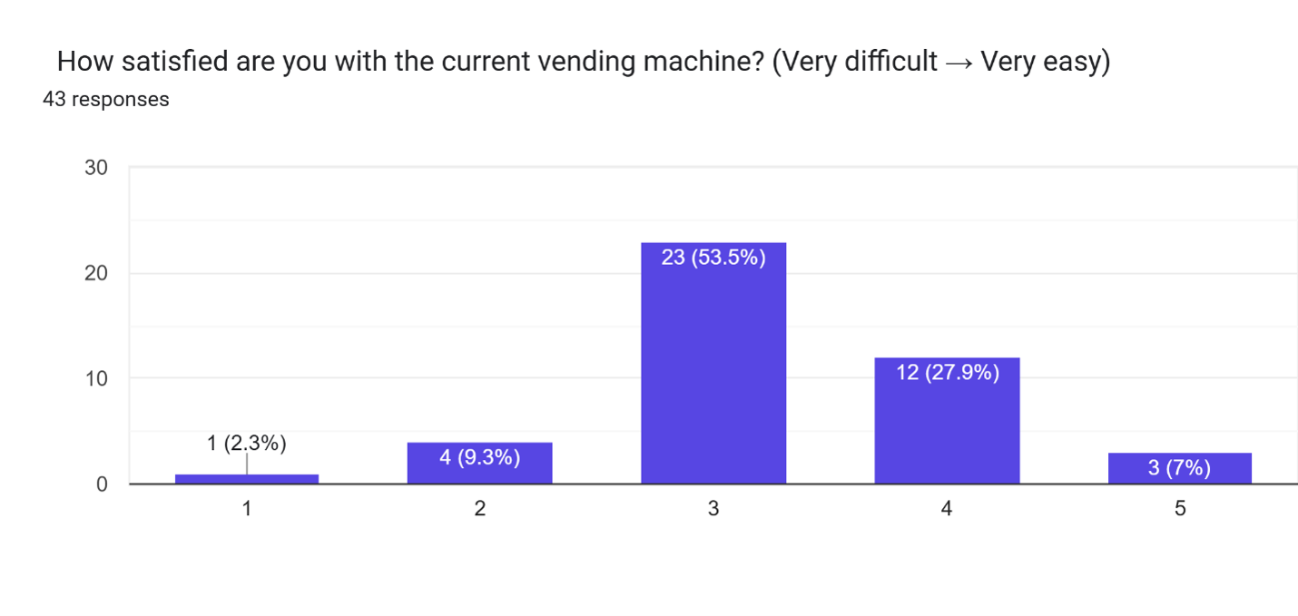
ALDOUS RESOURCES · VENDING MACHINE UI REDESIGN
SECTION 5.0
5.0
Evaluation — Satisfaction and Payment
34.9%
rate the current machine easy to use (4–5)
53.5%
stay neutral — the machine is only
"tolerable", not easy to use
67.4%
Figure 2. Student satisfaction ratings with the current
vending machine (n = 43).
have been confused by the payment process
at least once — clear payment steps are needed
▸ Most ratings sit in the middle — students do not love the current experience, they simply put up with it.
HCI 3202 · HUMAN COMPUTER INTERFACE · GROUP 1
07

Slide 8
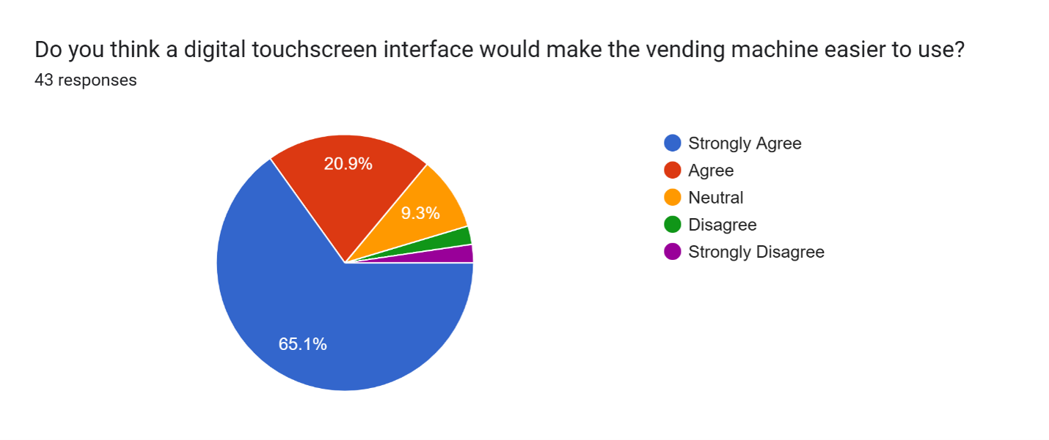
ALDOUS RESOURCES · VENDING MACHINE UI REDESIGN
SECTION 5.0
5.0
Evaluation — Demand for a Digital UI
86%
of students want a touchscreen interface —
65.1% strongly agree and 20.9% agree it would
make the machine easier to use
• Agreement is strong across all 43 responses
• Matches Malaysia's move towards cashless payment
• Confirms the survey supports the redesign — not just our own opinion
Figure 3. Student agreement that a digital touchscreen
interface would improve usability (n = 43).
▸ Demand is clear: students overwhelmingly believe a touchscreen would make the machine easier to use.
HCI 3202 · HUMAN COMPUTER INTERFACE · GROUP 1
08

Slide 9
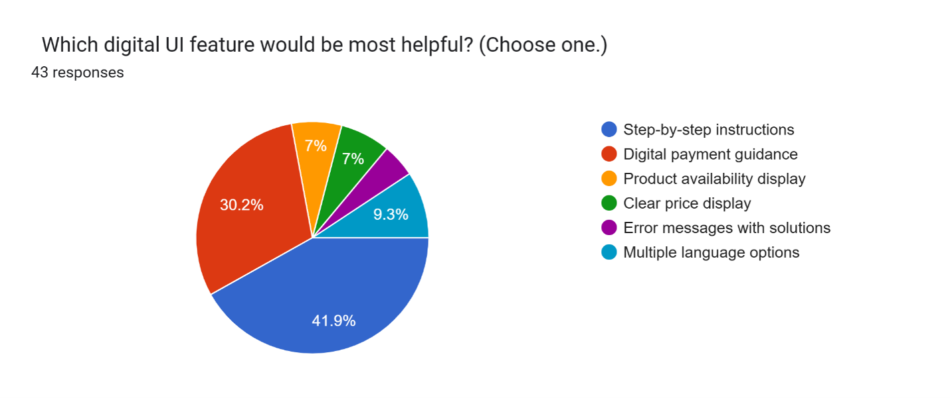
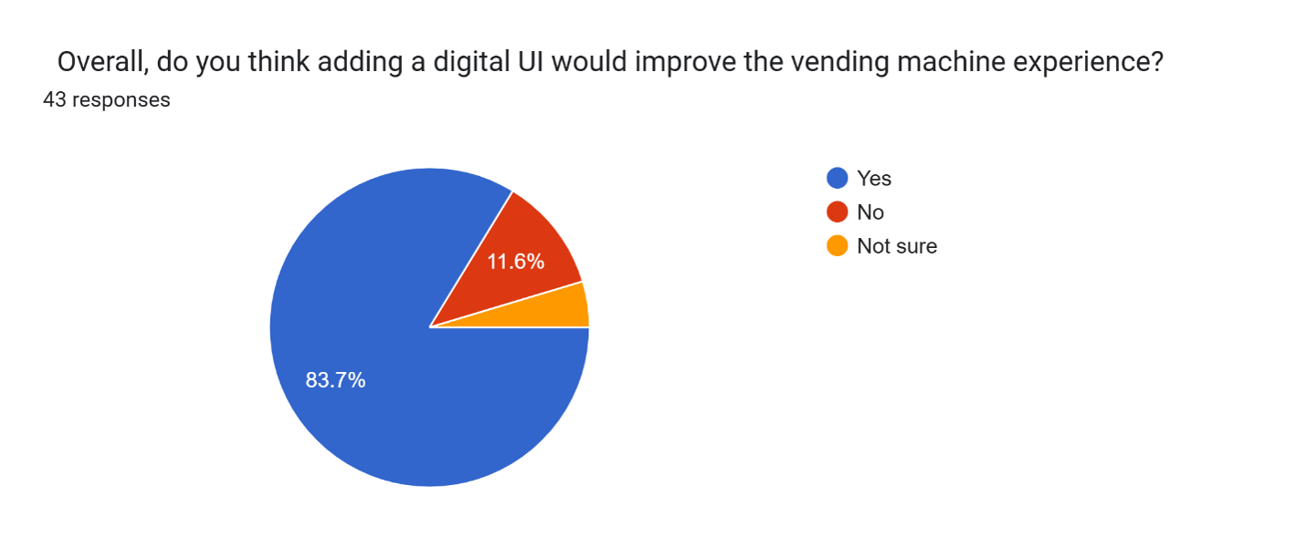
ALDOUS RESOURCES · VENDING MACHINE UI REDESIGN
SECTION 5.0
5.0
Evaluation — Features and Overall Impact
MOST HELPFUL DIGITAL FEATURE
OVERALL IMPACT OF A DIGITAL UI
Figure 4. Most helpful digital UI feature as selected
by students (n = 43).
Figure 5. Overall student opinion on whether a digital
UI would improve the experience (n = 43).
41.9% want step-by-step instructions
30.2% want digital payment information
→ These two directly shaped the guided 8-screen flow.
83.7% say a digital UI would improve the experience
69.8% would use the machine more often if digital
→ Strong evidence the redesign creates real value.
HCI 3202 · HUMAN COMPUTER INTERFACE · GROUP 1
09

Slide 10
ALDOUS RESOURCES · VENDING MACHINE UI REDESIGN
SECTION 6.0
6.0
Interaction Design — The Purchase Journey
Eight Figma screens cover the whole purchase — a linear, low-cognitive-load flow from browsing to order confirmation.
1 BROWSE
Main Dashboard — all products with prices
2 SELECT
Product Detail — photo, price, description
3 CONFIRM
Add to Cart — confirm before buying
4 REVIEW
Cart Page — items and running total
5 CHECKOUT
Checkout Page — order summary and total
6 PAY
Cash, Touch 'n Go or Card
7 RECOVER
Payment Failed — clear retry option
8 DONE
Order Confirmed — pickup instructions
Interactive Figma prototype:
figma.com/design — HCI Vending Machine UI
HCI 3202 · HUMAN COMPUTER INTERFACE · GROUP 1
10

Slide 11
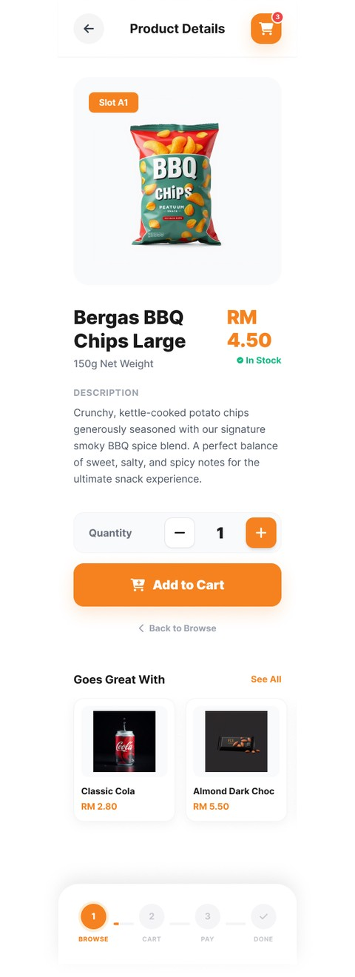
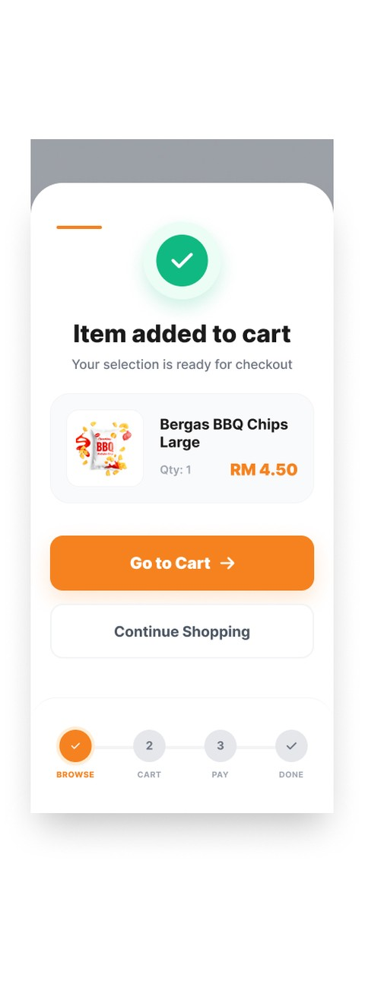
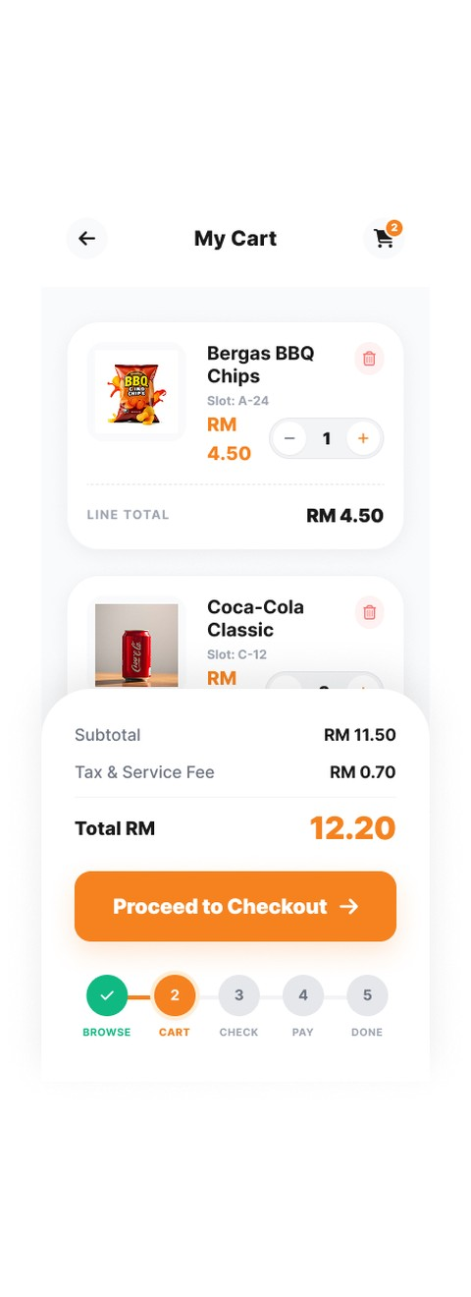
ALDOUS RESOURCES · VENDING MACHINE UI REDESIGN
SECTION 6.1
6.1
Prototypes — Browse to Cart (Screens 1–4)
Figure 6
Main Dashboard
Figure 7
Product Detail
Figure 8
Add to Cart Confirmation
Figure 9
Cart Page
HCI 3202 · HUMAN COMPUTER INTERFACE · GROUP 1
11

Slide 12
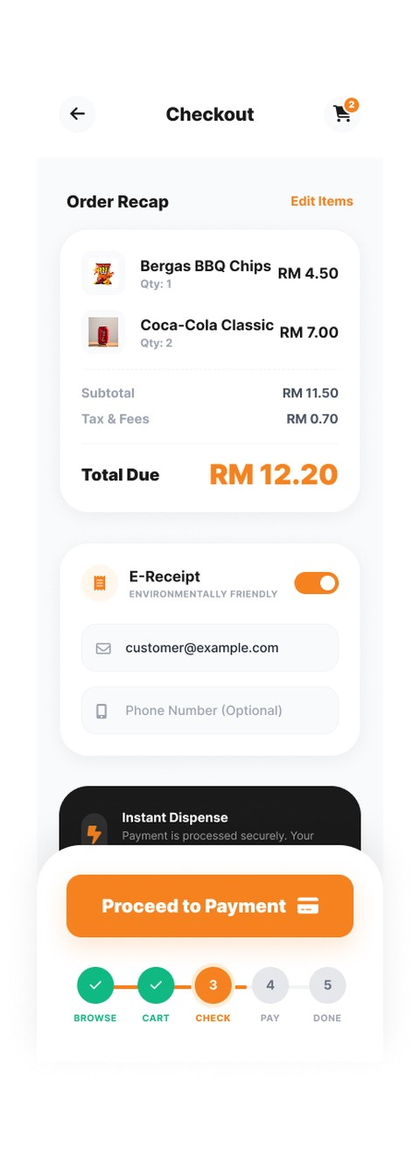
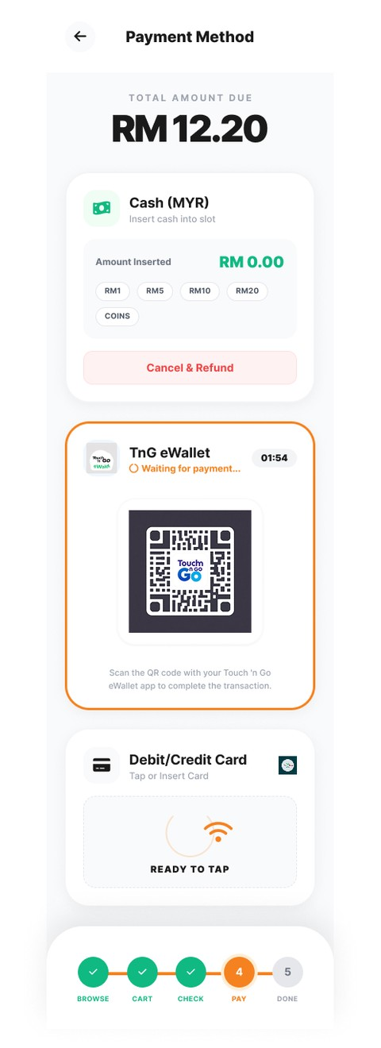
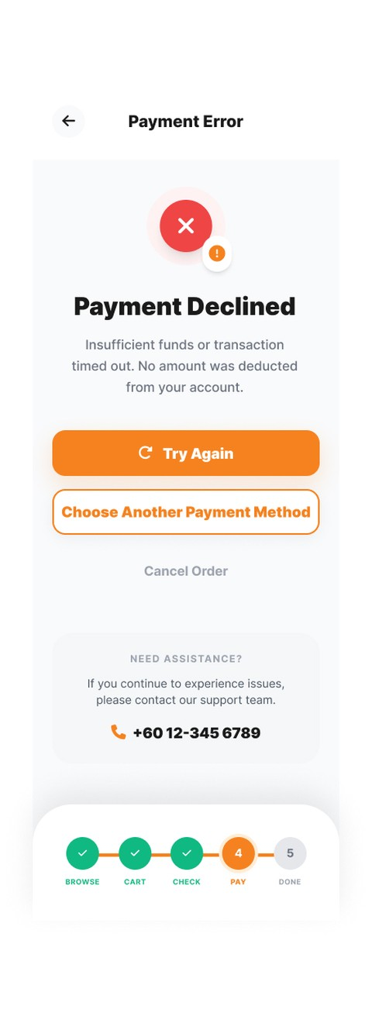
ALDOUS RESOURCES · VENDING MACHINE UI REDESIGN
SECTION 6.1
6.1
Prototypes — Checkout to Done (Screens 5–8)
Figure 10
Checkout Page
Figure 11
Payment Selection
Figure 12
Payment Failed
Figure 13
Order Confirmed
HCI 3202 · HUMAN COMPUTER INTERFACE · GROUP 1
12

Slide 13
ALDOUS RESOURCES · VENDING MACHINE UI REDESIGN
SECTION 6.2
6.2
Justification on Prototype Design
SURVEY SIGNAL
DESIGN ANSWER
Confusion over prices and
product availability
Main Dashboard + Product Detail show clear
photos, prices and stock at a glance
Risk of wrong purchases with
no way to go back
Add to Cart + Cart Page give review and control
before paying (Nielsen: user control and freedom)
67.4% were confused by the
payment process
Payment Selection offers guided choices —
Cash, Touch 'n Go, or Card
No feedback — users unsure the
machine registered their action
Payment Failed shows system status and clear
recovery steps (Nielsen, 2020; Kang et al., 2023)
14% paid but the product was
not dispensed
Order Confirmed closes the loop — success
message plus pickup instructions
HCI 3202 · THE LINEAR FLOW MATCHES THE 41.9% WHO ASKED FOR STEP-BY-STEP GUIDANCE
13

Slide 14
ALDOUS RESOURCES · VENDING MACHINE UI REDESIGN
SECTION 7.0
7.0
Conclusion
An 8-screen touchscreen UI, designed in Figma and grounded in survey
evidence and HCI heuristics, directly answers the real needs of INTI students.
01
The problem is real. 60.5% of students struggle with the manual machine —
payment confusion (53.5%) and unclear instructions (14%) lead the complaints.
02
The solution is guided. Eight linear screens give clear steps, visible prices,
simple cashless payment, and proper error recovery and confirmation.
03
The impact is supported. 83.7% believe a digital UI improves the experience and
69.8% would use the machine more often — the redesign meets proven demand.
HCI 3202 · HUMAN COMPUTER INTERFACE · GROUP 1
14

Slide 15
ALDOUS RESOURCES · VENDING MACHINE UI REDESIGN
SECTION 7.0
7.0
References
[1] Aljohi, A.S., Alzaabi, S.S., Almahri, R.S., Tsaramirsis, G. and Hamid, O.H. (2023) 'Navigating the Divide: Digital Kiosks and Mobile Apps as Complementary Human-Centered Self-Service Technologies', Engineering Proceedings, 59(1), p. 162. doi.org/10.3390/engproc2023059162 (Accessed: 17 July 2026).
[2] Ayob, M.A. and Baba, N. (2025) 'Self-ordering kiosk usage and purchase behavior in quick service restaurants: A case in Alor Setar's quick service restaurants', International Journal of Research and Innovation in Social Science, 9(15), pp. 779–789. doi.org/10.47772/IJRISS.2025.915EC0056 (Accessed: 17 July 2026).
[3] Kang, S., Kim, J. and Lee, S. (2023) 'Comparative Analysis of Usability and Accessibility of Kiosks for People with Disabilities', Applied Sciences, 13(5), p. 3058. doi.org/10.3390/app13053058 (Accessed: 17 July 2026).
[4] Nielsen, J. (2020) 10 Usability Heuristics for User Interface Design. Nielsen Norman Group. nngroup.com/articles/ten-usability-heuristics (Accessed: 17 July 2026).
HCI 3202 · HUMAN COMPUTER INTERFACE · GROUP 1
15

Slide 16
HCI 3202 · GROUP ASSIGNMENT
Thank You
Questions & Discussion
The "ALDOUS RESOURCES" Vending Machine User Interface Design using Figma
Group 1 — Shahadat Hossain · Rowan Cesar Macuacua · Raduan Mia · Morris Kinyua
Section 6H1 / 6MB1 · Lecturer: Kala Devi Managuran · JUN 2026
Slide and Figma Design Done By - Shahadat Hossain ID: I26041279

